Slide 1
Learning & Development Enabling development, Impacting growth…
Pig Programming – Module 1

Slide 2
Module Outline
Apache Pig Overview
Pig – Big Picture
Pig Features
How are Organizations using Pig?
The Pig Latin framework
Running Pig and its execution modes
Pig Interacting with HDFS
Interacting with Linux/ Unix
Running Pig in Interactive Mode
Running Pig script in batch mode
Pig Data Types
Data Types
Referencing Relations
Referencing Fields
Schemas
Relation without schema

Slide 3

Apache Pig Overview
Pig is one of important ecosystem in Hadoop framework to process or transform textual data for “Text Data analysis".
Pig is an alternative of MapReduce to process textual (structured, semi-structured, unstructured) data.
Originally developed as a research project at Yahoo
Goals: flexibility , productivity and maintainability
Now it is an open-source Apache Project
Notes:
What is Pig?
Apache Pig is a Hadoop platform for creating MapReduce jobs. Pig uses a high-level, SQL-like programming language named Pig Latin. The benefits of Pig include:
Run a MapReduce job with a few simple lines of code.
Process structured data with a schema, or Pig can process unstructured data without a schema. (Pigs eat anything!)
Pig Latin uses a familiar SQL-like syntax.
Pig scripts read and write data from HDFS.
Pig Latin is a data flow language, a logical solution for many MapReduce algorithms.
NOTE: Pig was created at Yahoo! to make it easier to analyze the data in your HDFS without the complexities of writing a traditional MapReduce program.
The developers of Pig published their philosophy to summarize the goals of Pig, using comparisons to actual pigs:
Pigs eat anything: Pig can process any data, structured or unstructured.
Pigs live anywhere: Pig can run on any parallel data processing framework, so Pig scripts do not have to run just on Hadoop.
Pigs are domestic animals: Pig is designed to be easily controlled and modified by its users.
Pigs fly: Pig is designed to process data quickly!

Slide 4
Apache Pig Overview (cont..)
Apache Pig is a platform for analyzing large data sets that consists of a high-level language for expressing data analysis programs, coupled with infrastructure for evaluating these programs.
Pig's infrastructure layer consists of
a compiler that produces sequences of Map-Reduce programs,
Pig's language layer currently consists of a textual language called Pig Latin, which has the following key properties:
Ease of programming. It is trivial to achieve parallel execution of simple, "embarrassingly parallel" data analysis tasks. Complex tasks comprised of multiple interrelated data transformations are explicitly encoded as data flow sequences, making them easy to write, understand, and maintain.
Optimization opportunities. The way in which tasks are encoded permits the system to optimize their execution automatically, allowing the user to focus on semantics rather than efficiency.
Extensibility. Users can create their own functions to do special-purpose processing.

Slide 5
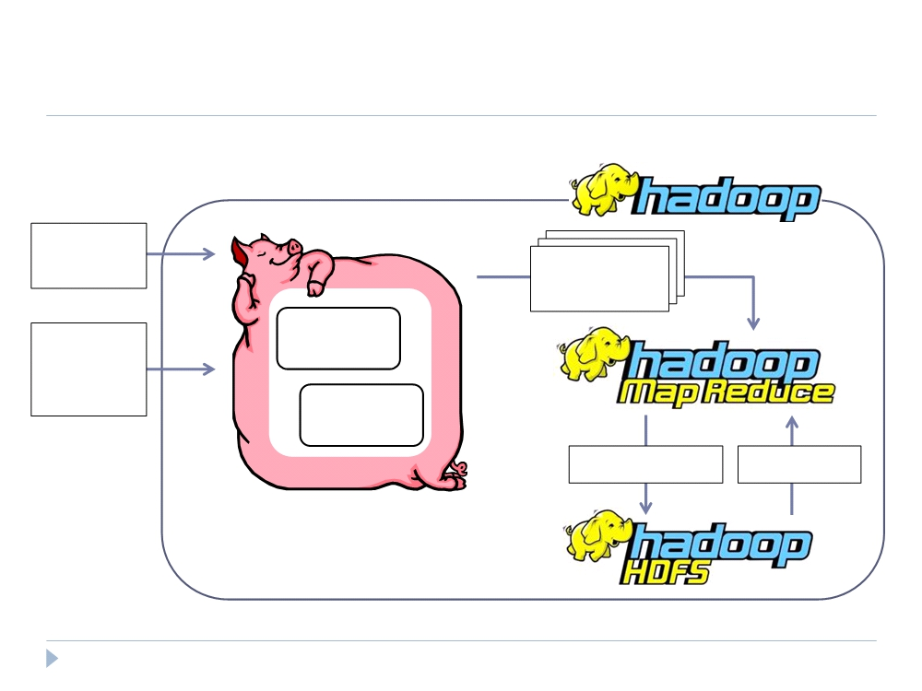
Pig – Big Picture
Pig
Pig Latin Script
Map-Reduce Statements
User-
Compile
Defined
Functions
Optimize
Write Results Read Data

Slide 6
Pig Features
Pig is an alternative to writing low-level MapReduce Code
Pig Provides sophisticated analysis and processing for
HDFC Manipulation
Unix Shell commands
Relational Operations
common mathematical functions
Supports Custom used defined functions (UDF's)
Provides complex data structures

Slide 7
How are Organizations using Pig?
Usage of Pig
Many Organization use Pig for data analyses to
Find relevant records in a massive data
Querying multiple data sets
Calculating values from input data
Pig also frequently used for data processing that includes
Reorganizing an existing data set
Joining dataset from multiple sources to produce a new data set.
However, Organization uses 80% of Pig features for data processing purpose

Slide 8
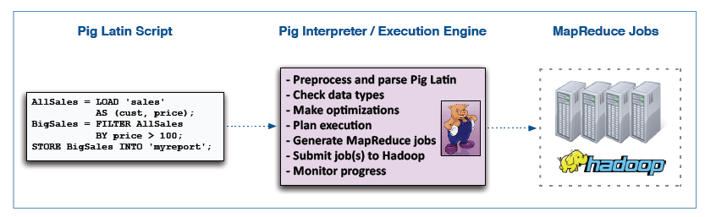
The Pig Latin framework
Main components of Pig
The data flow language (Pig Latin)
The Interactive shell where you can type Pig Latin Statements (Grunt shell)
The Pig Interpreter and execution engine

Slide 9
The Pig Latin framework (cont..)
Pig Latin" language is used to define data flows in Pig transformation. Pig
Latin is called as data-flow language. Dataflow is a collection of data pipes
wherein each pipe is an operation.
The Operations can be loading data, transformation, data sorting, grouping of data, filtering data, aggregation etc
Notes:
Java/C/C++ etc are control flow structured language where as Pig Latin is data flow language. In Pig Latin, without complex programming control structures, you can define complex data flows. Hence, from one pipe to another pipe, data transforms from one state to other state.

Slide 10
Running Pig
You can run Pig (execute Pig Latin statements and Pig commands) using various modes:
 | Local Mode | Tez Local Mode | Mapreduce Mode | Tez Mode
Interactive Mode | yes | experimental | yes | yes
Batch Mode | yes | experimental | yes | yes

Slide 11
Pig - Execution Modes
Local Mode
Tez Local Mode
Mapreduce Mode
Tez Mode
Notes:
Local Mode - To run Pig in local mode, you need access to a single machine; all files are installed and run using your local host and file system. Specify local mode using the -x flag (pig -x local).
Tez Local Mode - To run Pig in tez local mode. It is similar to local mode, except internally Pig will invoke tez runtime engine. Specify Tez local mode using the -x flag (pig -x tez_local). Note: Tez local mode is experimental. There are some queries which just error out on bigger data in local mode.
Mapreduce Mode - To run Pig in mapreduce mode, you need access to a Hadoop cluster and HDFS installation. Mapreduce mode is the default mode; you can, but don't need to, specify it using the -x flag (pig OR pig -x mapreduce).
Tez Mode - To run Pig in Tez mode, you need access to a Hadoop cluster and HDFS installation. Specify Tez mode using the -x flag (-x tez).

Slide 12
Pig - Execution Modes (cont..)
Examples
This example shows how to run Pig in local and mapreduce mode using the pig command.
local mode
$ pig -x local ...
Tez local mode
$ pig -x tez_local
Tez mode
$ pig -x tez
mapreduce mode
$ pig ... or
$ pig -x mapreduce

Slide 13
Pig Interacting with HDFS
grunt> fs -mkdir sales/;
grunt> fs -put europe.txt sales/;
grunt> fs -get europt.txt ;
grunt> fs -getmerge myreport/bigsales.txt

Slide 14
Interacting with Linux/ Unix
grunt> sh date → display unix default date and time
grunt> sh ls ----> listing files from local file system
grunt> fs ls ----> listing files from default HDFS path
grunt> sh mkdir test ----> creating test directory in default local file systems
grunt> fs mkdir test ---> creating test directory in default HDFS

Slide 15
Running Pig in Interactive Mode
You can run Pig in interactive mode using the Grunt shell.
Invoke the Grunt shell using the "pig" command (as shown below) and then enter your Pig Latin statements and Pig commands interactively at the command line.
The DUMP operator will display the results to your terminal screen.
grunt> A = load 'passwd' using PigStorage(':');
grunt> B = foreach A generate $0 as id;
grunt> dump B;

Slide 16
Pig Scripts
Use Pig scripts to place Pig Latin statements and Pig commands in a single file
It is good practice to create the file using the .pig extension, however it is not mandatory.
Comments in Script:
You can include comments in Pig scripts:
For multi-line comments use
/*myscript.pig My script is simple. It includes three Pig Latin statements …. */
For single-line comments use
--
Eg: A = LOAD 'student' USING PigStorage() AS (name:chararray, age:int, gpa:float); -- loading data

Slide 17
Pig – Use Cases

Slide 18
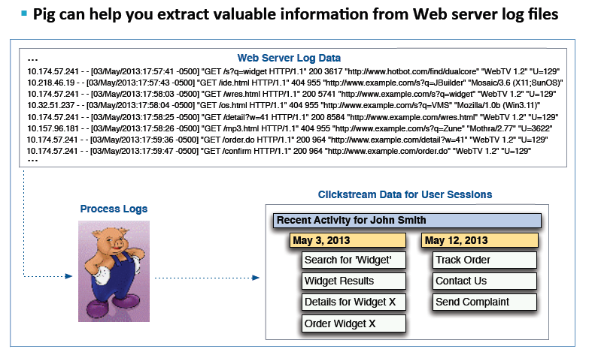
Pig – Use Cases : Web Server log
Pig can help to extract valuable information from Web Server log files

Slide 19
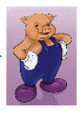
Pig – Use Cases : Random Sampling
Pig Can used to spit data from large data set into smaller segment
Allows to examine this portion with tools that do not scale well
Supports faster during development of analysis jobs
25 TB
100 TB
10TB
35 TB
Random Sampling
30TB

Slide 20
Pig – Use : ETL Tool
Pig uses widely as ETL tool
Source 1
Extract
Transform
Load
Target
Source 2
Source 3

Slide 21
Data Types
Simple Data Types | Description | Example
Scalars
int | Signed 32-bit integer | 10
long | Signed 64-bit integer | Data: 10L or 10l Display: 10L
float | 32-bit floating point | Data: 10.5F or 10.5f or 10.5e2f or 10.5E2F Display: 10.5F or 1050.0F
double | 64-bit floating point | Data: 10.5 or 10.5e2 or 10.5E2 Display: 10.5 or 1050.0
Arrays
chararray | Character array (string) in Unicode UTF-8 format | hello world
bytearray | Byte array (blob)
Complex Data Types
tuple | An ordered set of fields. | (19,2)
bag | An collection of tuples. | {(19,2), (18,1)}
map | A set of key value pairs. | [open#apache]

Slide 22
Data Types (cont..)
fields default to type bytearray
Implicit conversions are applied to the data depending on the context in which t
For example, in relation B, f1 is converted to integer because 5 is integer.
In relation C, f1 and f2 are converted to double because we don't know the type of either f1 or f2.hat data is used
A = LOAD ‘salaries.txt ' AS (gender,age,income);
B = FOREACH A GENERATE age + 5;
C = FOREACH A generate age + income;

Slide 23
Data Types (cont..)
If a schema is defined as part of a load statement, the load function will attempt to enforce the schema.
If the data does not conform to the schema, the loader will generate a null value or an error.
A = LOAD ‘salaries.txt‘ AS (gender:chararray, age:int, income:float,zip:int);
If an explicit cast is not supported, an error will occur
A = LOAD ‘salaries.txt' AS (gender:chararray, age:int, income:float);
B = FOREACH A GENERATE (int)age;
This will cause an error …

Slide 24
Q & A

Slide 25
Thank You
Review Date | 25-May-2016
Version | 1.0
Next Review Due | 15-July-2016

